Slide 1
ODK Aggregate: Setting up an ODK Aggregate account
Dr. Caroline Krafft
St. Catherine University
cgkrafft@stkate.edu
Version: January 14, 2018

Slide 2
Setting up ODK Aggregate

Slide 3
ODK Aggregate: Options
ODK Aggregate is the ready-to-deploy server and data repository
Provides blank forms to tablets
Accepts finalized forms (submissions)
Manage collected data
Can deploy to Google’s App Engine (we walk through this)
Alternatively can deploy locally on a Tomcat server (or any serverlet 2.5-compatible (or higher) web container) backed with a SQL database server
See http://opendatakit-dev.cs.washington.edu/1_0_tools/aggregate/tomcat_install
Note: ODK Sync Endpoints is a more technically advanced alternative

Slide 4
ODK Aggregate: Installation
Download ODK Aggregate here.
If you run into any issues installing, refer to the ODK Aggregate instructions page. There is also ODK Forum for any questions you may have:
https://forum.opendatakit.org
Notes:
http://opendatakit-dev.cs.washington.edu/2_0_tools/download_version
http://docs.opendatakit.org/aggregate-install/
https://forum.opendatakit.org/

Slide 5
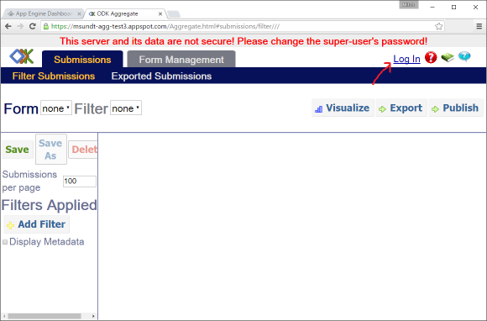
ODK Aggregate: An Example from Google API
Following this URL will bring us to the test ODK Aggregate server.
Next steps would be to click “Log In” and enter the username and password.
Notes:
https://opendatakit-tablesdemo.appspot.com/Aggregate.html#odkTables/viewCurrentTables///

Slide 6
ODK Aggregate
The top of the screen will look like this. Go to Site Admin.

Slide 7
Roles
ODK Aggregate allows users different capabilities:
Data Collector - able to download forms to ODK Survey and submit data to ODK Aggregate.
Data Viewer - able to log onto the ODK Aggregate website, filter and view submissions, and generate csv files for download.
Form Manager - all the capabilities of a Data Viewer plus the abilities to upload a form definition, delete a form and its data, and upload submissions manually through the ODK Aggregate website.
Synchronize Tables - able to download, upload and alter data records within ODK Tables as restricted by table-access privileges granted to the user.
Tables Super-user - able to administer row-level and table-access privileges.
Administer Tables - able to administer tables and row-level and table-access privileges.
Site Administrator - all the capabilities of a Form Manager plus the ability to add users, set passwords, and grant these capabilities to other users.

Slide 8
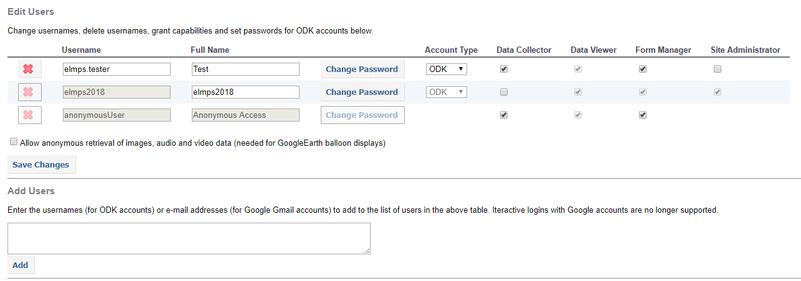
ODK Aggregate: Permissions and Users
You are the site administrator.
If you are using a dummy tester, you can either create a new gmail account or create an ODK account to be the tester.
Once you’ve created an account, enter the username into “Add Users”.
Under “Edit Users”, you can set unique passwords for the data collectors.
Make sure to save changes.

Slide 9
Adding ODK Tables

Slide 10
ODK Tables
Tables is a program that allows you to visualize and edit data, revisiting existing data and syncing it with an ODK Aggregate instance in the cloud.
Using Tables as your entry-point to data collection, you will be able to gather data using ODK Survey, sync it to a server, and have other users download and edit the data on their own devices.
You will need to add ODK Tables on ODK Aggregate

Slide 11
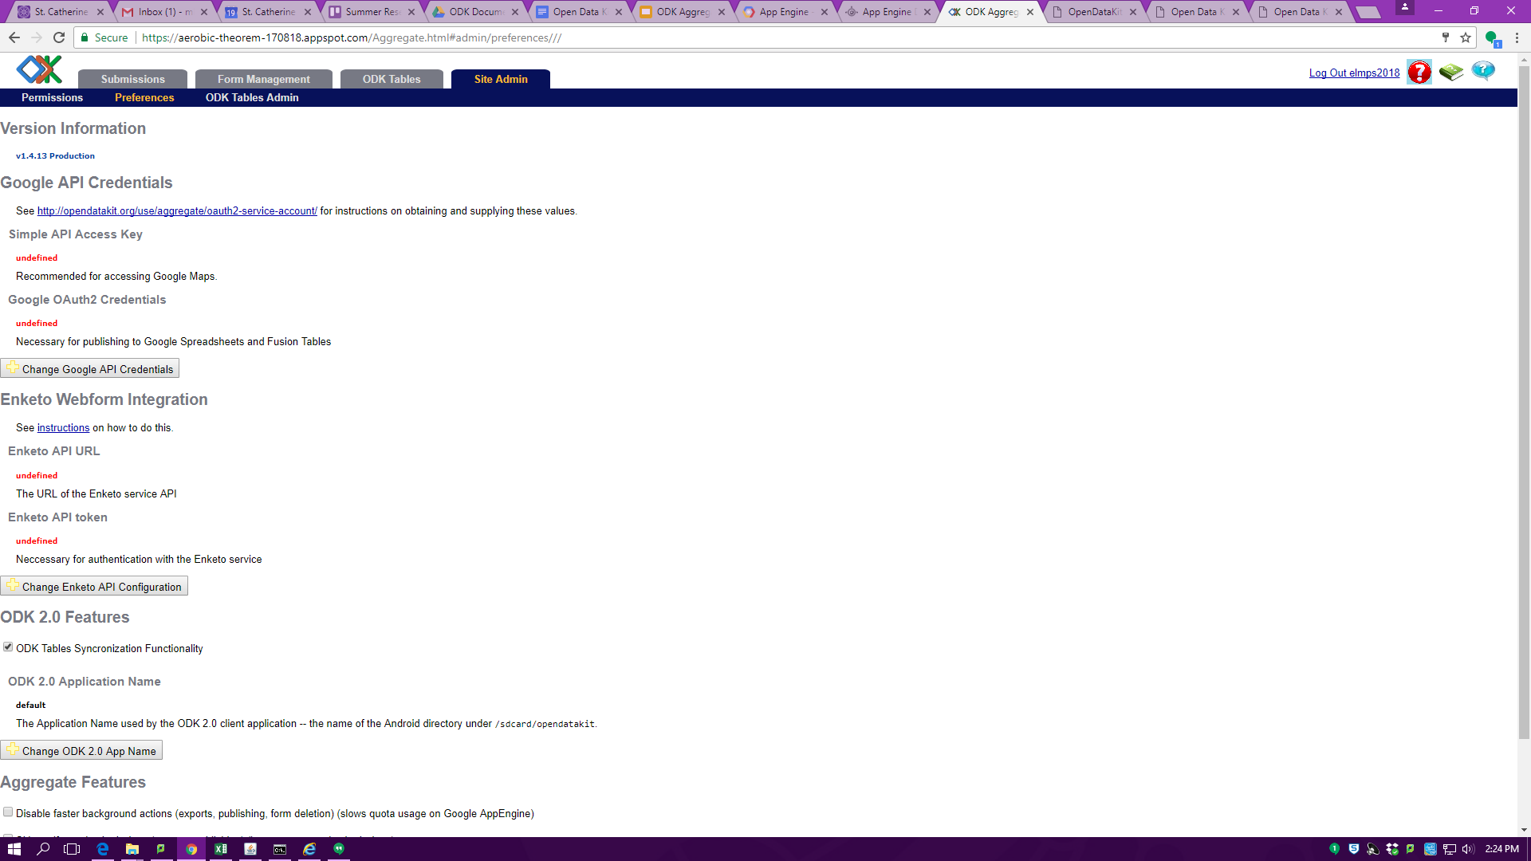
ODK Tables in ODK Aggregate
4
1
2
To add ODK Table into Aggregate you
must have Administrator status.
1. First click on Site Admin tab
2. Then click on Preferences
3. Next, under ODK 2.0 Feature click the box underneath (Sync functionality)
4.Finally, a tab should appear named “ODK Tables”
5. Now, anything you do on your ODK tables app on your tablet should show up under this tab once you have synced your devices
3

